Slide 1

Computer Hard ware
Computer hardware is the physical parts or components of a computer, such as the monitor, mouse, keyboard,computer data storage, hard disk drive (HDD), graphic cards, sound cards, memory, motherboard, and so on, all of which are physical objects that are tangible.

Slide 2

Components Of Hardware
Input-i/p
Output-o/p
Memory Unit-MU
Arithimetic &logic Unit-ALU
Central Processing Unit-CPU

Slide 3

Input-I/P
A term for a physical piece of hardware that connects to a primary device, such as a computer, in order to provide user input.
Examples:
Keyboards
Mouse devices
Joysticks
Microphones
And web cameras

Slide 4
Output-O/P
An output device is used to send data from a computer to another device or user.
Examples:
printers and plotters (physical reproduction in the form of text or graphics).

Slide 5
Memory Unit
The memory unit is a component of a computer system. It is used to store data, instructions and information. It is also known as a principal/primary/internal memory.
There are two types of memory: –
1.RAM(Random Access Memory)
2.ROM(Read-Only-Memory)

Slide 6
Arithimetic & logic Unit
ALU is a main component of the central processing unit, which is used to performs an arithmetic and logic operations.
Here the Arithmetic operations represents:-1.Addition
2.Subtraction
3.Multiplication
4.Division
5. Mod Division
And the Logical operations represents:-NOR
NOT
AND
OR….etc

Slide 7
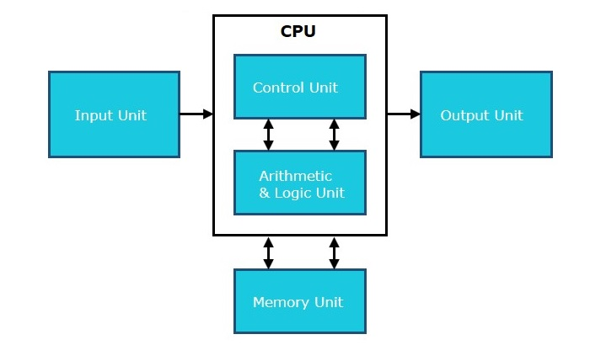
Central Processing Unit
The central processing unit (CPU) is the primary component of any digital computer system, consisting of the main memory, the control unit, and the arithmetic-logic unit. ... The central processing unit's control unit regulates and integrates the computer's operations.

Slide 8

THANK YOU

